Slide 1
The Relational Database Model

Slide 2
Content
Table
Keys
Integrity rules
Relational set operators
The data dictionary
Relationships within the relational database
Index

Slide 3
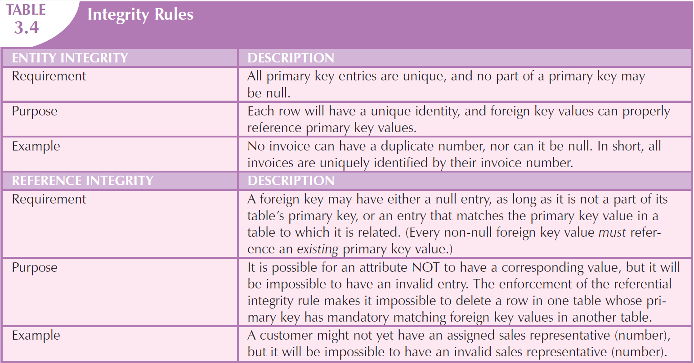
Integrity Rules

Slide 4
Entity Integrity
Requirement
All primary key entries must be unique, and no part of the primary key can be a null value.
Purpose
Each row (each record) must have a unique identifier, allowing foreign key values to correctly correspond to primary key values.
Example
All invoice numbers are non-repeating and cannot be null, allowing each invoice to be uniquely identified by its invoice number.

Slide 5
Reference Integrity
Requirement
A foreign key, as long as it is not part of the table's primary key, can be null or correspond to a value of a primary key in a related table. (Every non-null foreign key value must reference an existing primary key value).
Purpose
An attribute may not have a corresponding value, but it cannot have an invalid value. Using referential integrity, if a foreign key in one table corresponds to a primary key value in another table, then that primary key value cannot be deleted.
Example
A customer may not have a designated salesperson (number), but they cannot have an invalid salesperson (number).

Slide 6
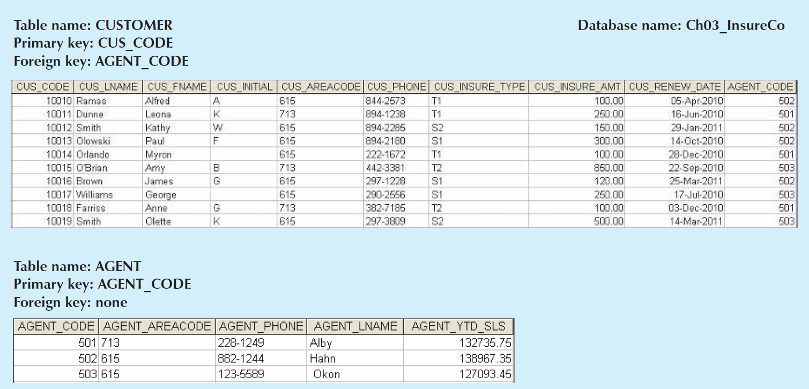
An illustration of integrity rules

Slide 7
Relational Set Operators
Data manipulation capabilities
Relational algebra
SELECT
PROJECT
UNION
INTERSECT
DIFFERENCE
PRODUCT
JION
DIVIDE

Slide 8
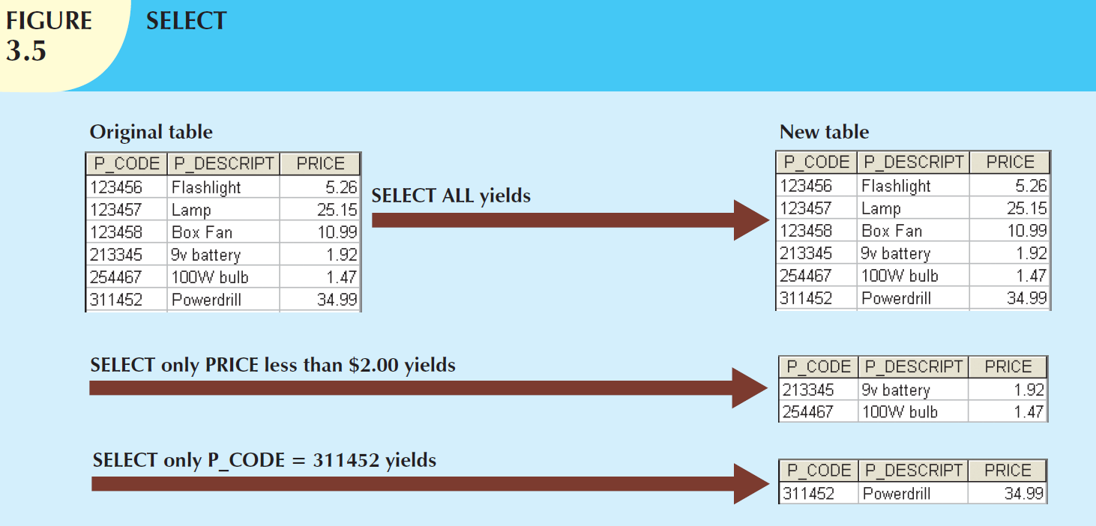
SELeCET
Yields values for all rows found in a table the satisfy a given condition.
SELECT * FROM school.`student table`;

Slide 9
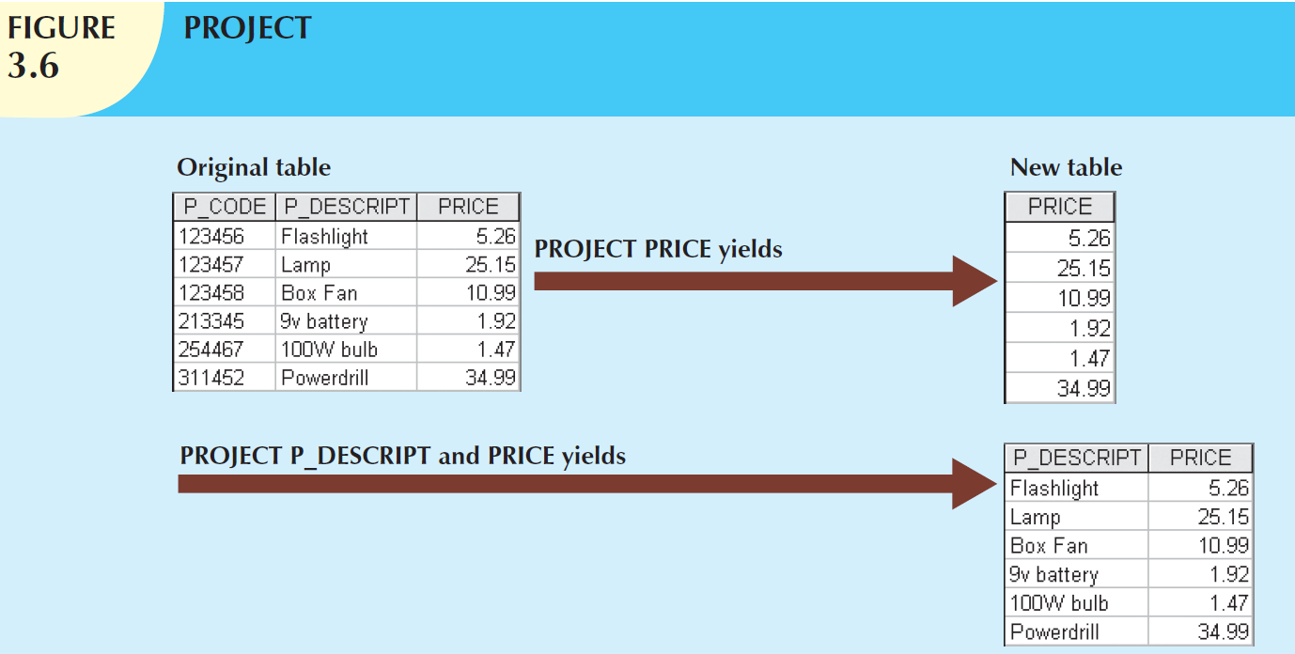
PROJECT
PROJECT yields all values for selected attributes.
PROJECT yields a vertical subset of a table.
SELECT `Name` FROM school.`student table`;

Slide 10
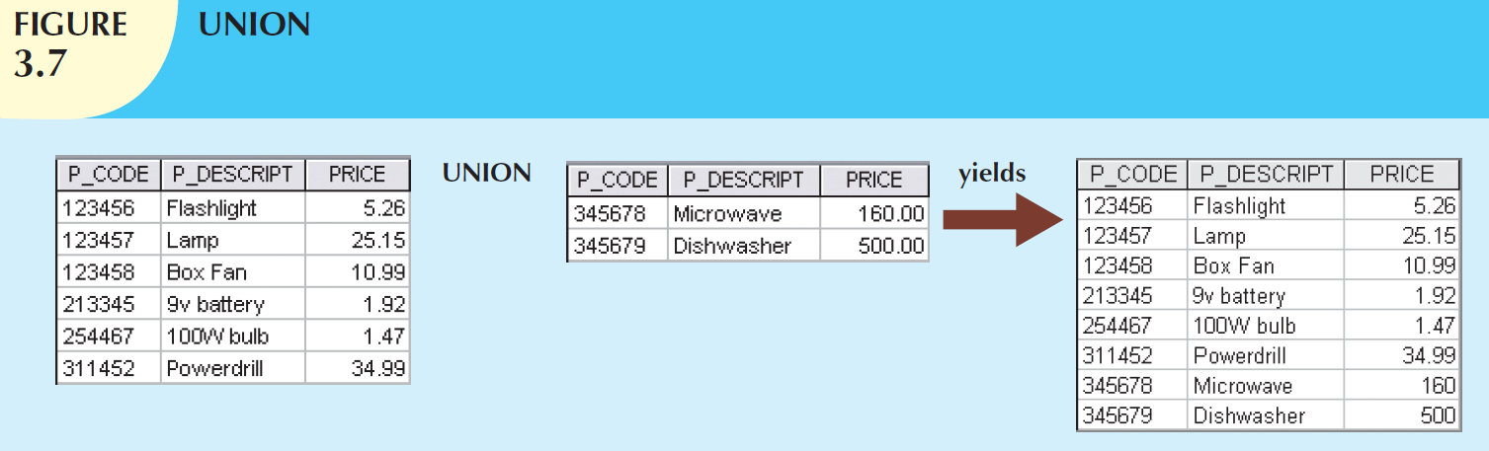
UNION
Combines all rows from two tables, excluding duplicate rows.
The tables must have the same attribute characteristics (the columns and domains must be compatible).
SELECT `CourseID` FROM `course table`
union
SELECT `Sid` FROM `student table`;

Slide 11
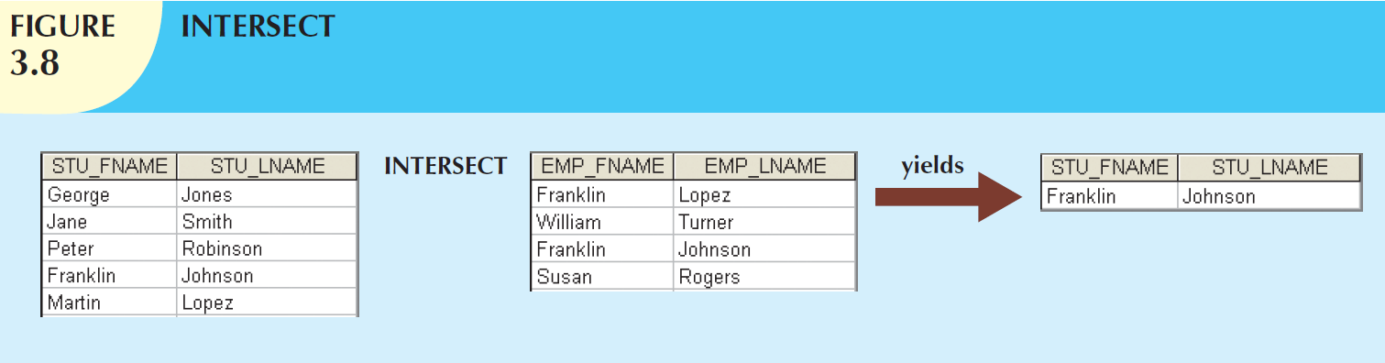
INTERSECT
Yields only the rows that appear in both tables.
MySQL Workbench does not support the INTERSECT operator (for personalized user recommendations).
use school;
SELECT * FROM `student table`
where `student table`.Sid in ( select Sid from `enroll table` E1 join `enroll table` E2 using (Sid)
where E1.CourseID = 102
AND E2.CourseID = 101);

Slide 12
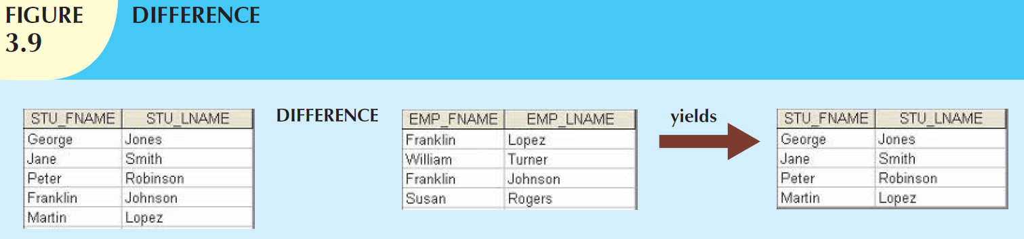
DIFFERENCE
Yields all rows in one table that are not found in the other table; that is, it subtracts one table from the other.
MySQL Workbench does not support the EXCEPT (or difference) operator.
use school;
SELECT * FROM `student table`
where `student table`.Sid not in (select Sid from `enroll table` where CourseID = 102);

Slide 13
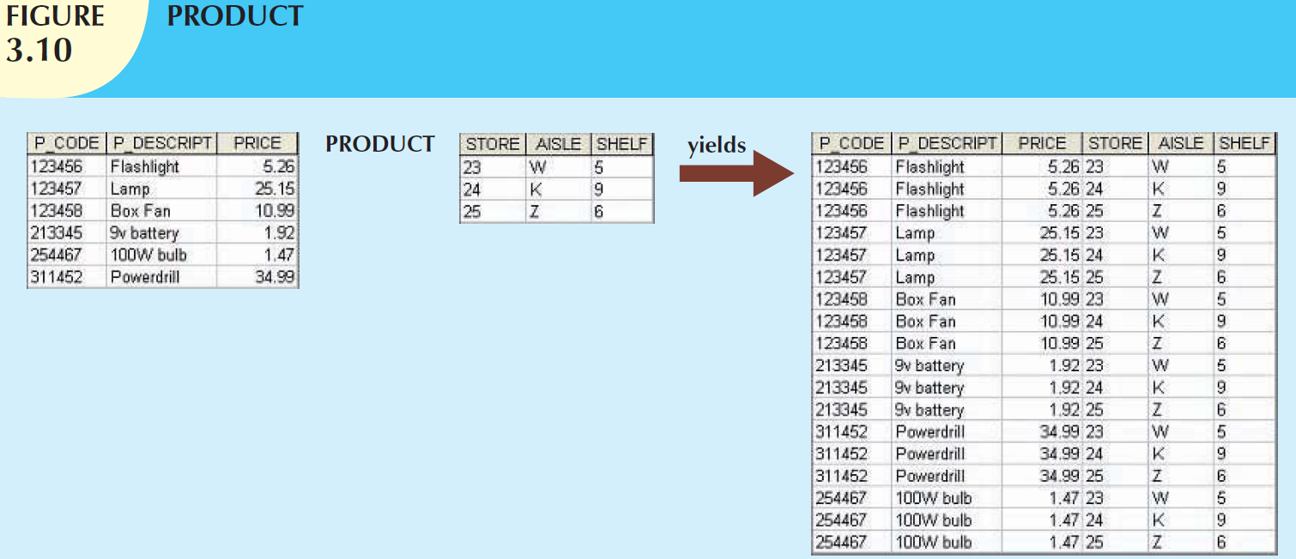
PRODUCT
Yields all possible pairs of rows from two tables
—also known as the Cartesian product.
SELECT * FROM `student table` S1 join `student table2`;

Slide 14
JION
JOIN allows information to be combined from two or more tables.
Natural join
Inner join
Outer join
Equijoin

Slide 15
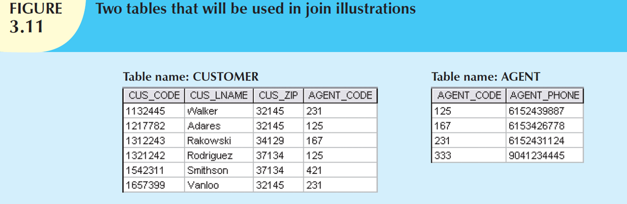
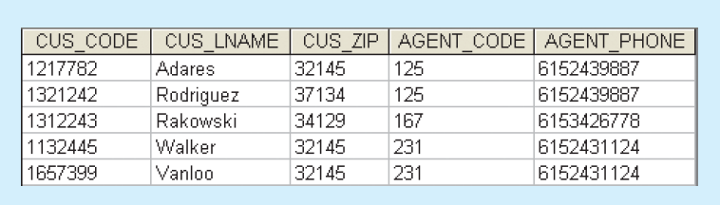
A natural join links tables by selecting only the rows with common values in their common attribute(s).
SELECT * FROM school.`student table` natural join school.`enroll table`;

Slide 16
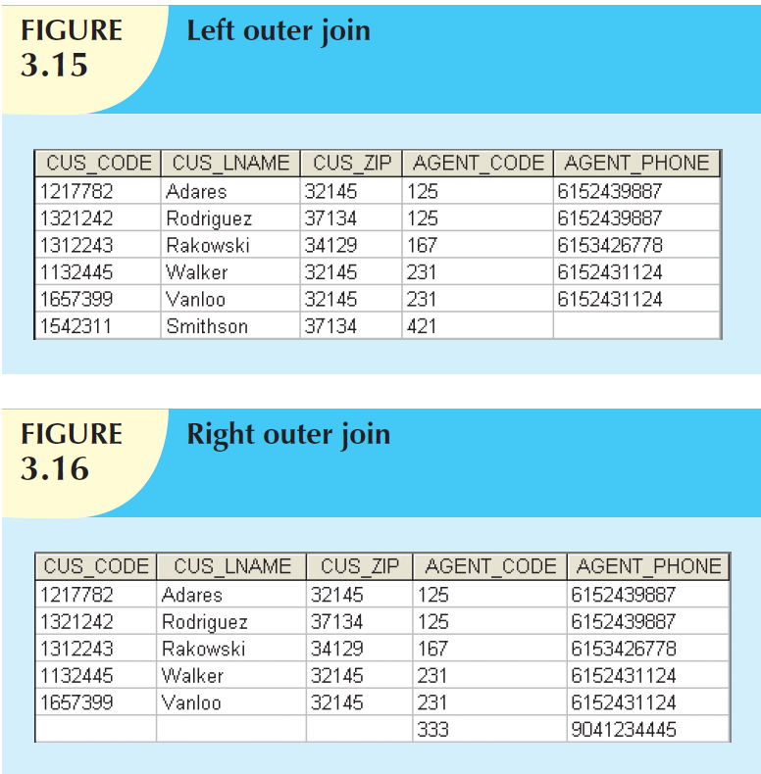

Slide 17
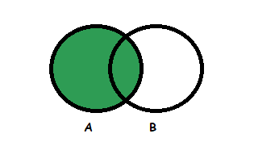
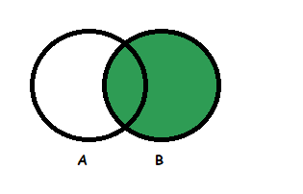
Join
Left Outer Join: Left Outer Join returns all the rows from the table on the left and columns of the table on the right is null padded. Left Outer Join retrieves all the rows from both the tables that satisfy the join condition along with the unmatched rows of the left table.
Right Outer Join: Right Outer Join returns all the rows from the table on the right and columns of the table on the left is null padded. Right Outer Join retrieves all the rows from both the tables that satisfy the join condition along with the unmatched rows of the right table.

Slide 18
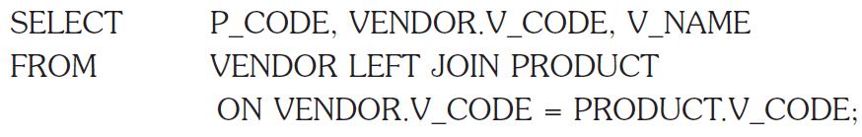
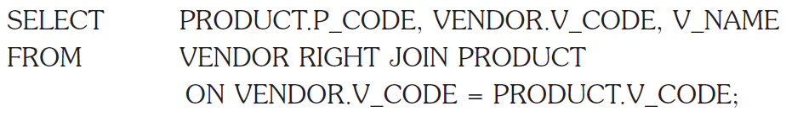
7.8.3 Outer joins 外连接
There are two types of outer joins: left and right.

Slide 19
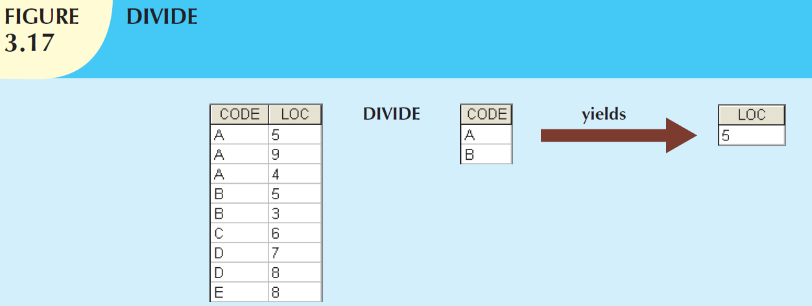
DIVIDE
use school;
SELECT * FROM `student table`
where `student table`.Sid in (select Sid from `enroll table` where CourseID = 102);
Divisor: one single-column table
Dividend: one 2-column table
Both tables have a common column

